Slide 1

Chapter 10 – System Architecture
Version 2 – 18th December 2015

Slide 2

Prescribed Text and recommended readings
Prescribed text
Rosenblatt, H. J. (2016), Systems Analysis and Design.11th Edition, Cengage Learning, Boston MA
Prescribed reading
Robertson, S. and Robertson, J. (2013), Mastering the Requirements Process: Getting Requirements Right, 3rd Edition, Addison Wesley, Upper Saddle River, NJ
IIBA (2015), Guide to the Business Analysis Body of Knowledge, BABOK Version 3.0, International Institute of Business Analysis, http://www.iiba.org/BABOKGuide.aspx

Slide 3
Chapter Objectives
Provide a checklist of issues to consider when selecting a system architecture
Trace the evolution of system architecture from mainframes to current designs
Explain client/server architecture, including tiers, cost-benefit issues, and performance
Compare in-house ecommerce development with packaged solutions and service providers

Slide 4
Chapter Objectives cont.….
Discuss the impact of cloud computing and Web 2.0
Define network topology, including hierarchical, bus, ring, star, and mesh models
Describe wireless networking, including wireless standards, topologies, and trends
Describe the system design specification

Slide 5
Architecture Checklist
Issues that influence the architecture choice
Corporate organization and culture
Enterprise resource planning (ERP)
Initial and total cost of ownership (TCO)
Scalability
Web integration
Legacy system interface requirements
Processing options
Security issues
Corporate portals

Slide 6
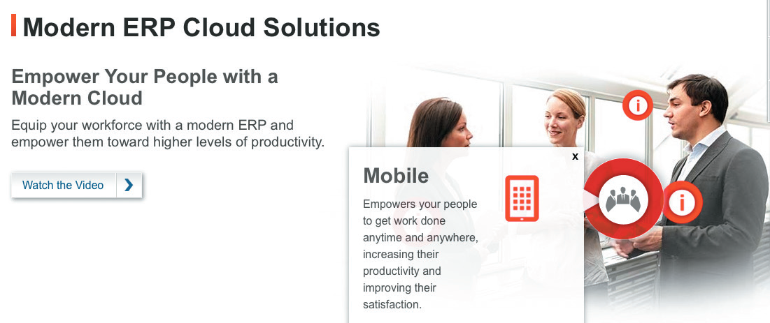
Architecture Checklist
Corporate Organization and Culture
A successful system performs well in a company’s organization and culture
Enterprise resource planning (ERP)
Objective – To establish a company-wide strategy for using IT that includes:
a specific architecture
standards for data
Processing
network, and
user interface design
FIGURE 10-1 Oracle offers ERP solutions as a cloud-based service.
Source: Oracle

Slide 7
Architecture Checklist
Companies are extending internal ERP systems to their suppliers and customers, using supply chain management (SCM)
Initial Cost and TCO
TCO includes tangible purchases, fees, and contracts called hard costs
TCO analysis answers questions about the validity, effectiveness, and new trends in systems planning
May affect the initial cost and TCO for a proposed system

Slide 8
Architecture Checklist
Scalability (Extensibility)
A system’s ability to expand, change, or downsize easily to meet the changing needs of a business enterprise
Web Integration
A web-centric architecture enables a company to integrate new applications into its ecommerce strategy
Legacy Systems
A new system might have to interface with legacy systems
Involves analysis of data formats and compatibility

Slide 9
System Architecture: Then and Now
Functions of a business information system
Manage applications that perform the processing logic
Handle data storage and access
Provide an interface that allows users to interact with the system
While planning system design:
Determine where the functions will be carried out
Identify the advantages and disadvantages of each design approach

Slide 10
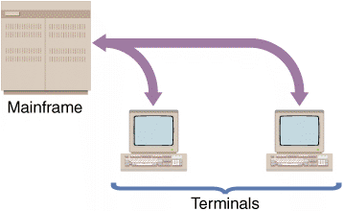
System Architecture: Then and Now
Mainframe Architecture
Server: A computer that supplies data, processing services or other support to one or more computers called clients
Earliest servers - Mainframe computers
All data input and output occurred at a central location
Advances in technology enabled installation of terminals at remote locations
FIGURE 10-3 In a centralized design, the remote user’s keystrokes are transmitted to the mainframe, which responds by sending screen output back to the user’s screen.

Slide 11
System Architecture: Then and Now
Impact of the Personal Computer
Individuals could work in stand-alone mode
The workstation performed all the functions of a server
Lesser IT assistance resulted in increased productivity in certain tasks
Absence of a central storage location raised concerns about data security, integrity, and consistency
Network Evolution
Local area network (LAN): Allows sharing of data and hardware resources
Wide area network (WAN): Spans long distances and can connect LANs that are continents apart

Slide 12
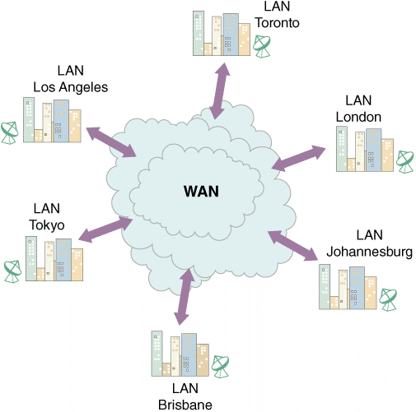
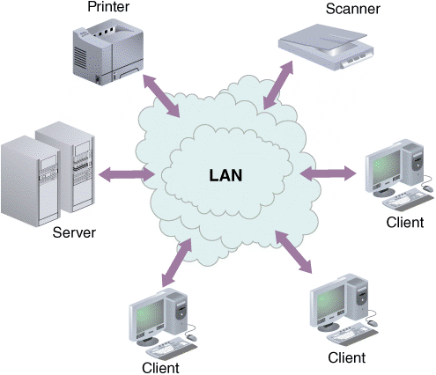
System Architecture: Then and Now
FIGURE 10-4 A LAN allows sharing of data and hardware, such as printers and scanners.
FIGURE 10-5 A WAN can connect many LANs and link users who are continents apart.

Slide 13
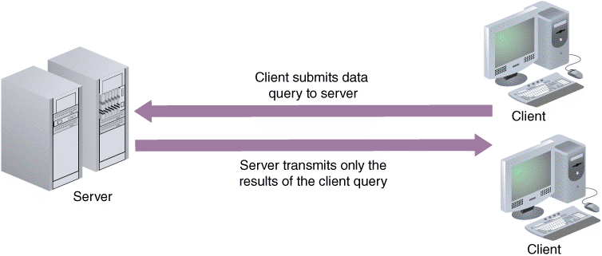
Client/Server Designs
Client/Server Architecture
Includes systems that divide processing between one or more networked clients and a central server
Client handles the entire user interface
Server stores data and provides data access and database management functions
FIGURE 10-6 In a client/server design, data is stored and usually processed on the server.

Slide 14
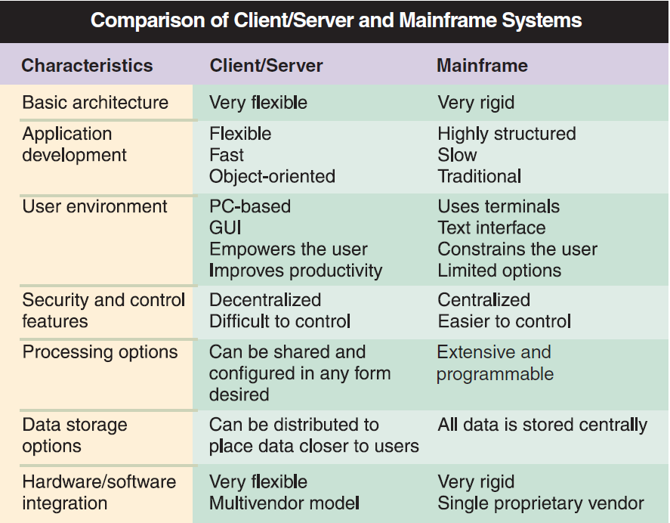
Client/Server Designs
FIGURE 10-7 Comparison of the characteristics of client/server and mainframe systems.

Slide 15
Client/Server Designs
The Client’s Role
Client/server relationship must specify how the processing will be divided between the client and the server
Fat client (thick client) design: Locates all or most of the application processing logic at the client
Thin client design: Locates all or most of the processing logic at the server
Provides better performance as the program code resides on the server

Slide 16
Client/Server Designs
Client/Server Tiers
Two-tier design
User interface resides on the client
Data resides on the server
Application logic can run either on the server or on the client, or be divided between the client and the server
Three-tier (n-tier) design
User interface runs on the client
Data is stored on the server
Has a middle layer between the client and server
Processes the client requests and translates them into data access commands
Considered an application server

Slide 17
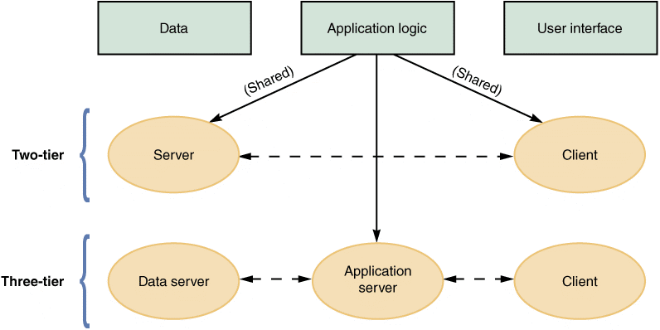
Client/Server Designs
FIGURE 10-8 Characteristics of two-tier versus three-tier client/server design.

Slide 18
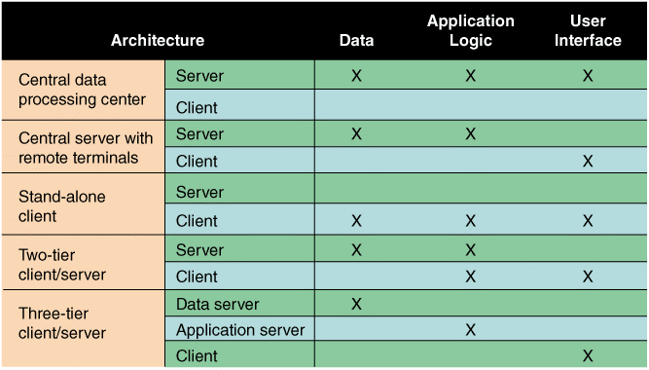
Client/Server Designs
FIGURE 10-9 The location of the data, the application logic, and the user interface depend on the type of architecture.

Slide 19
Client/Server Designs
Middleware
Enables communication between the tiers
Referred to as glueware
Used to connect two or more software components in a federated system architecture
Integrates legacy systems and Web-based and/or cloud applications
Represents the slash in the term client/server
Cost-Benefit Issues
Client/server systems offer the best combination of features to meet information system requirements

Slide 20
Client/Server Designs
Enable firms to scale the system according to the environment
Enable transfer of applications from expensive mainframes to less-expensive client platforms
Reduce workload and improve response times
Performance Issues
Knee of the curve
Response time to requests increases significantly as the system nears its capacity
Client should contact the server only when necessary in a client/server system
Distributed database management system (DDBMS) helps improve client/server performance

Slide 21
The Impact of the Internet
In an Internet-based architecture, the entire user interface is provided by the web server in the form of HTML documents
Shifting the responsibility for the interface from the client to the server simplifies data transmission and results in lower hardware cost and complexity

Slide 22
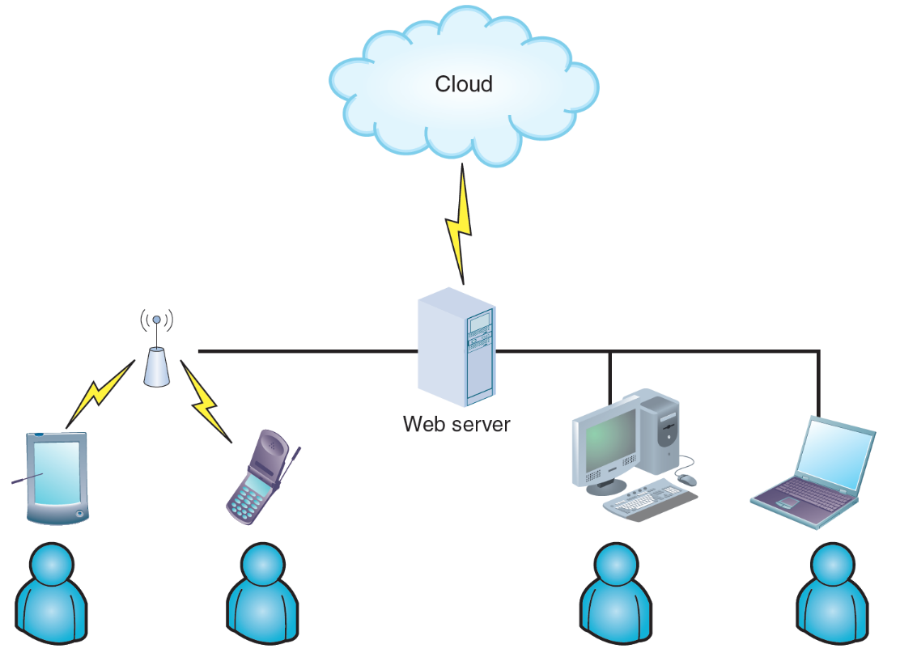
The Impact of the Internet
Cloud Computing
The concept envisions a cloud of remote computers providing a total online software and data environment that is hosted by third parties
Eliminates compatibility issues and provides scaling on demand
FIGURE 10-10 Cloud computing

Slide 23
The Impact of the Internet
Web 2.0
Second generation of the web
Enables people to collaborate, interact, and share information more dynamically
Considered a step towards the semantic web
Wiki: Web-based repository of information
Run by social collaboration
Users collaborate and add new layers of information to the Internet operating system

Slide 24
Ecommerce Architecture
In-House Solutions
Benefits
A unique website, with a look and feel consistent with the company’s other marketing efforts
Complete control over the organization of the site
A scalable structure to handle increases in sales and product offerings in the future
More flexibility to modify and manage the site
The opportunity to integrate the firm’s web-based business systems with its other information systems

Slide 25
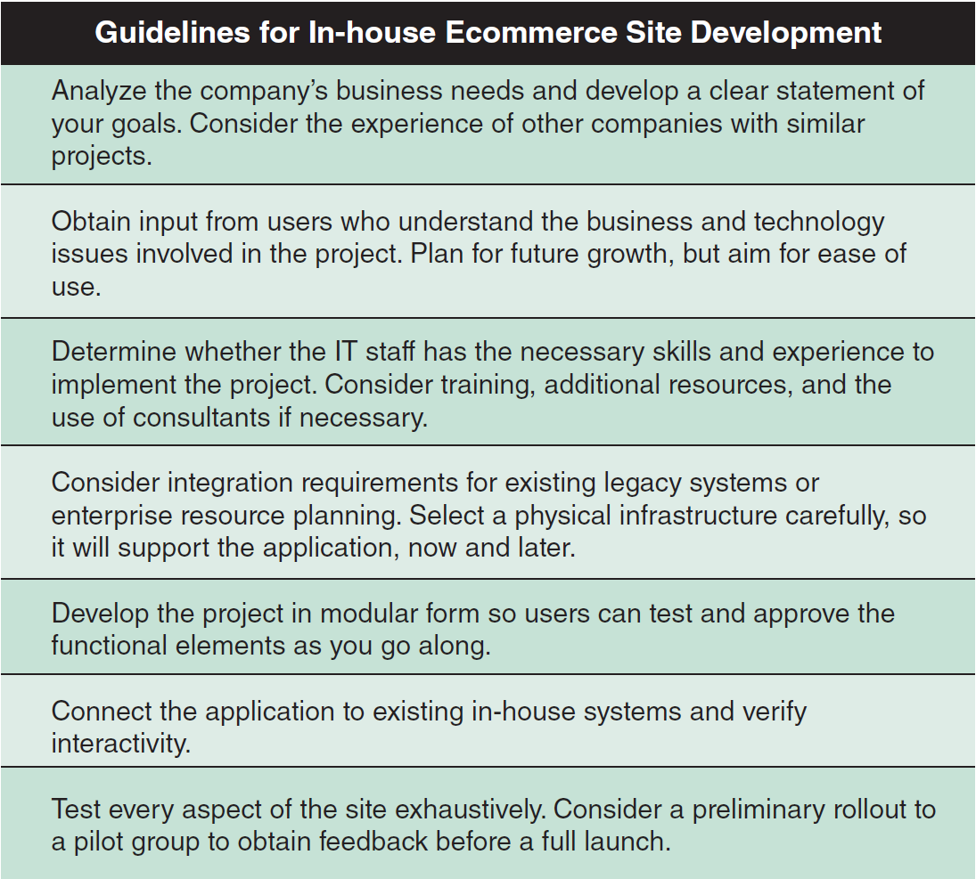
Ecommerce Architecture
FIGURE 10-11 Guidelines for companies developing ecommerce strategies.

Slide 26
Ecommerce Architecture
Packaged Solutions
Viable alternative for medium- to large-sized firms
Less complex than an in-house effort
Service Providers
Application service provider (ASP) - Provides applications or access to applications by charging a fee
Many ASPs offer full-scale Internet business services for companies that decide to outsource functions

Slide 27
Network Models
The Open Systems Interconnection (OSI) Model
Describes how data moves from an application on one computer to an application on another networked computer
Provides physical design standards that assure seamless network connectivity, regardless of the specific hardware environment

Slide 28
Network Models
Network Topology
Topology - Physical or logical view of the network
Physical topology: Actual network cabling and connections
Logical topology: Describes the way the components interact
Hierarchical network
Departmental servers control lower levels of processing and network devices
Bus network
A single communication path connects the central server, departmental servers, workstations, and peripheral devices

Slide 29

Network Models
Ring network
Resembles a circle where the data flows in only one direction from one device to the next
Star network
Has a central networking device called a switch which manages the network and acts as a communications conduit for all network traffic
Mesh network
Each node connects to every other node
Figure 10-15 Although these computers form a physical circle, the physical layout has no bearing on the network topology, which might be a bus, ring, star, or other logical design.

Slide 30
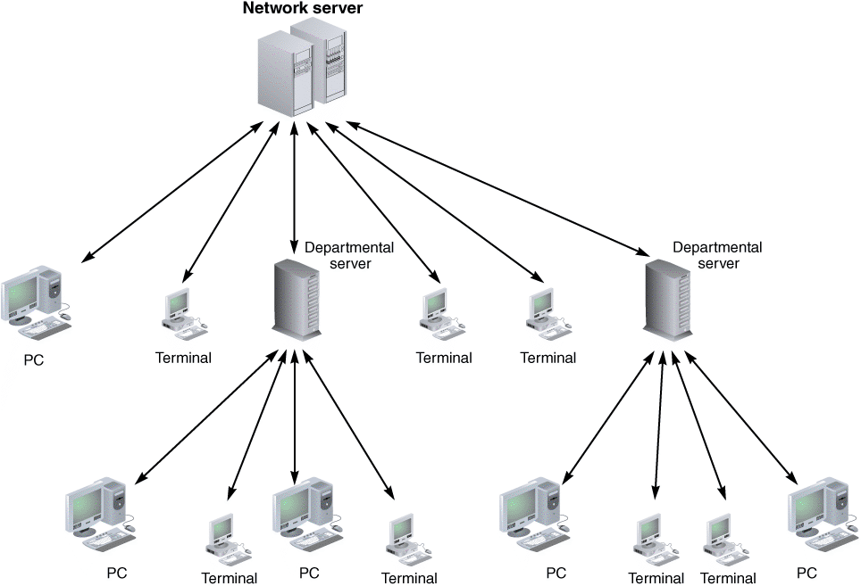
Network Models
FIGURE 10-16 A hierarchical network with a single server that controls the network.

Slide 31
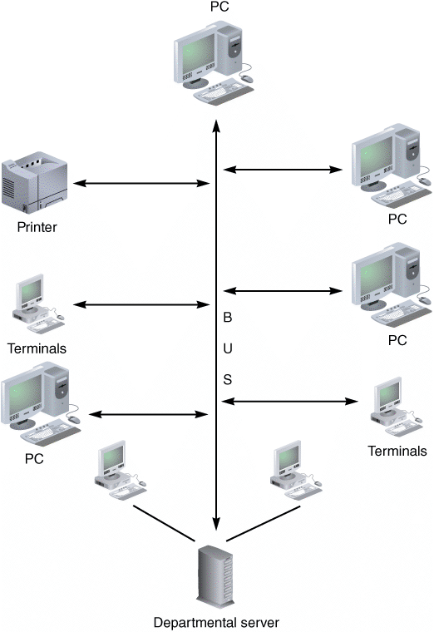
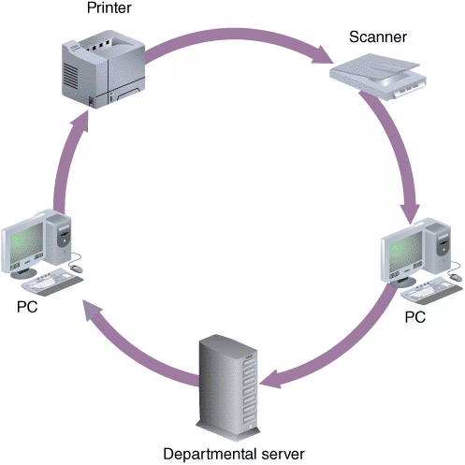
Network Models
FIGURE 10-18 A ring network with a set of computers that send and receive data flowing in one direction.
FIGURE 10-17 A bus network with all devices connected to a single communication path.

Slide 32

kent.edu.au Kent Institute Australia Pty. Ltd. ABN 49 003 577 302 ● CRICOS Code: 00161E ● RTO Code: 90458 ● TEQSA Provider Number: PRV12051

